Slide 1
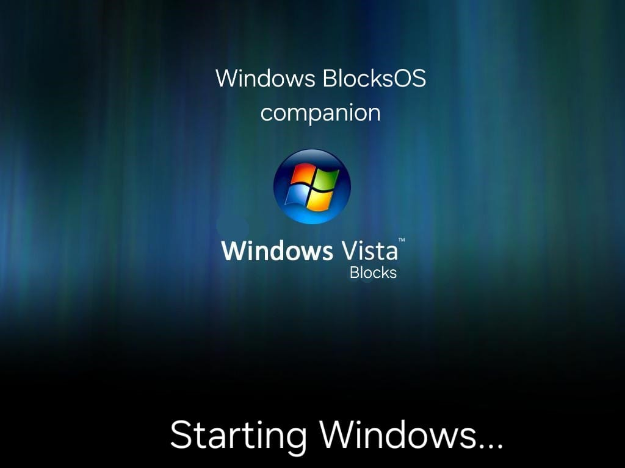

Slide 2

Welecome
User

Slide 3



Slide 4

Start

Slide 5


Music

Slide 6
Power off
Shut down…

Slide 7
